Slide 1
Agile Requirements Management
SIMS Introduction 1/9 2021
Henrik Florén

Slide 2
SIMS in short
You will work on solving a real problem for a company/organisation
The firm/organisation contributes its time on formulating the problem, acting as a customer, user and tester of your results.
Hence, a great opportunity to learn about development projects in practice
What are the key challenges?
How do you start?

Slide 3
To begin with…
Step 1 is to understand what you are supposed to do → what are the development requirements of your customer?
Q: What do you know about requirement management in product- and service development?
Q: What have you learned in previous courses?
Discuss in your group (or contemplate individually) during two minutes…

Slide 4
What is Requirement Management?
Requirements Management is the systematic collection of the requirements to be placed on a product or service.
Requirements management involves communication between the project team members and stakeholders, and adjustment to requirements changes throughout the course of the project.
Failures in product development can often often be traced to mistakes early in the development process.

Slide 5
Input questions & propositions
Q: How difficult is it to understand customer needs/product requirements?
It’s difficult, as “customers” don’t always know their needs!
Customers are notoriously bad at describing what they want – in particular as to new or improved products and services.
Proposition: “The focus should not be on what products customers want, but on what jobs they are trying to get done. “ (Tony Ulwick, Founder Strategyn)

Slide 6
Input questions & propositions
Q: How difficult is it to define the characteristics of the best solution early in a development project?
In most cases, it is difficult to understand the end-result up front!
Proposition: Learning together with ”customers” during development activities are key to success → Agile Development

Slide 7
Product Development =
Product Discovery + decide WHAT to build
doing the right thing
Product Delivery decide HOW to build it
doing the thing right

Slide 8
Course objectives (about product discovery) IG019A
Learning Objectives
The students shall show:
ability to identify the need of products and services
ability to suggest products and develop services based on users' preconditions and needs
ability to suggest products and develop services based on a value creating focus
ability to formulate requirements specifications

Slide 9
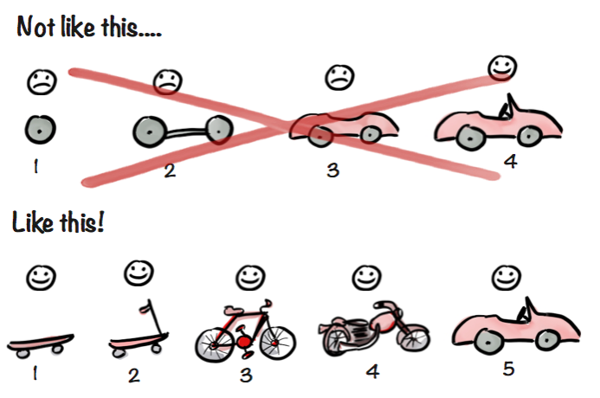
Basic principles of Agile development
https://blog.crisp.se/2016/01/25/henrikkniberg/making-sense-of-mvp

Slide 10
Key Challenges
Understanding customer value is truly difficult (as they tend not to know what they want/need)
Solution = learn about the customer/problem(s) and the solution
Listen to the customer but do not assume that they fully know what they need – that is something that you need to discover together in the discovery process.
If the case includes the customer’s customer: include them!
Dare to test before you have all the answers → mechanism for learning

Slide 11
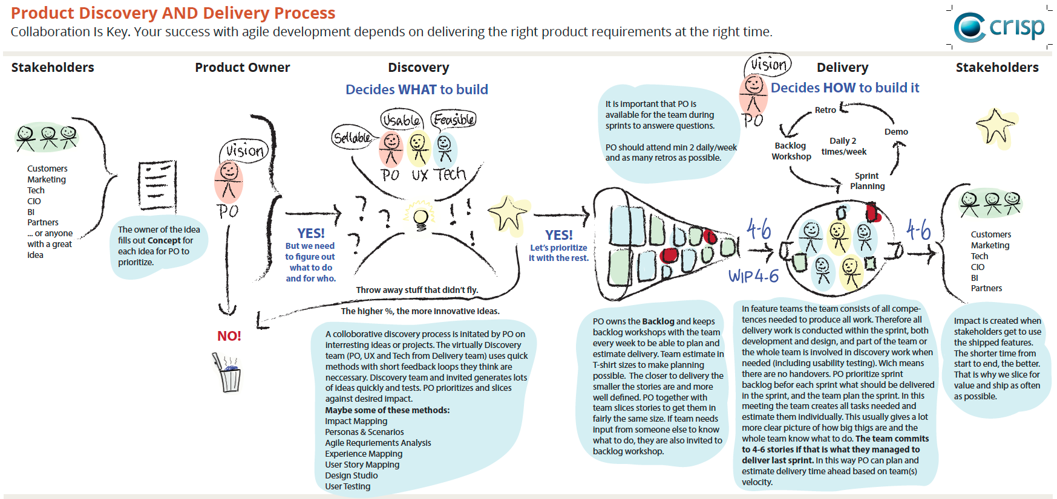
Basic principles of Agile development
Source: https://dandypeople.com/blog/example-of-product-discovery-and-delivery-process-with-one-team/

Slide 12
Product Discovery Figure out WHAT to do for WHO? Input: A problem, need or goal Output: A prioritized list of features or user stories

Slide 14
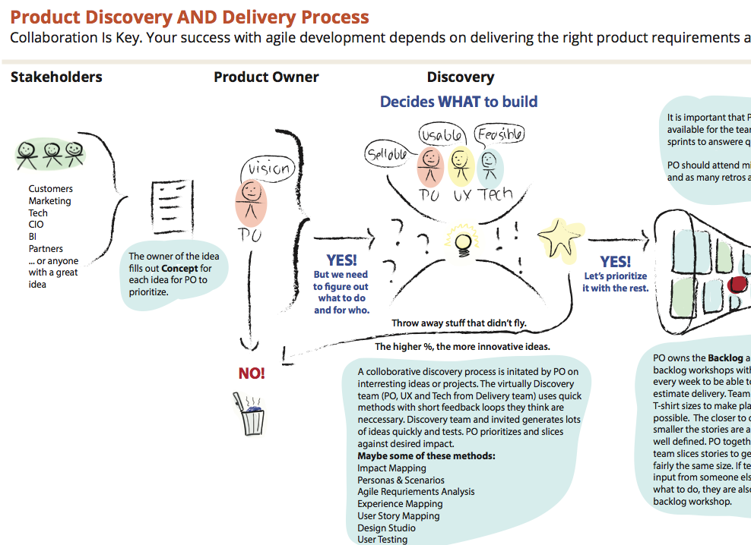

Slide 15
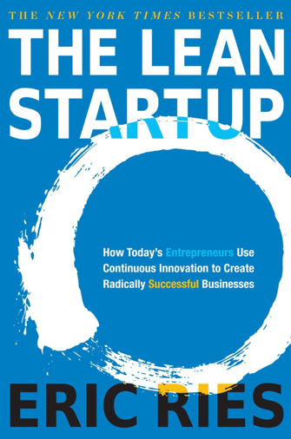




There is not ONE method for agile requirements management...

Slide 16
…but they do have some parts in common
Start with:
Understanding the users and their needs (hence, do not start with a focus on the solution!)
Set the goal

Slide 17
Preparation for the first meeting with the company…

Slide 18
You should discuss and answer questions such as
For whom are we solving this problem?
Which user needs are we trying to address?
What customer insights do we have available to inform the solution (customer support, analytics, market research, user research, competitive analysis, etc.)?
How can we measure our success?
What non-functional requirements do we have (such as law, security, availability, standards)?

Slide 19

The Value Proposition Canvas (VPC)
https://www.strategyzer.com/blog/value-proposition-canvas-a-tool-to-understand-what-customers-really-want

Slide 20
The Value Proposition Canvas (VPC)
Download VPC at: https://www.strategyzer.com/canvas/value-proposition-canvas

Slide 21
Product Delivery Decide HOW to build it Input: A prioritized list of features or user stories and a team with different competences Output: A working prototype and a high-performing team

Slide 22
Course objectives (about product discovery) IG019A
Learning Objectives
The students shall show:
abilities to lead and manage projects according to a motivated project management model
ability to work and cooperate in a team
ability to plan and carry through a project within given time frames

Slide 23
Course objectives DT053A
Learning Objectives
The student will be able to: - choose and apply adequate methods for test-driven and agile system development

Slide 24
Agile
Scrum is one example of an agile method for ”product delivery”
[Check out www.scrum.org for additional information]

Slide 25
Product Development =
Product Delivery decide HOW to build it
doing the thing right
Product Discovery + decide WHAT to build
doing the right thing
You will need methods/tools for both of the above, based on knowledge from previous courses

Slide 26
Thanks for your attention!
Any Questions?

